Slide 1
ELECTROSTATICS
CSPC 132
MR. MARK OFORI NKETIA

Slide 2


Slide 3
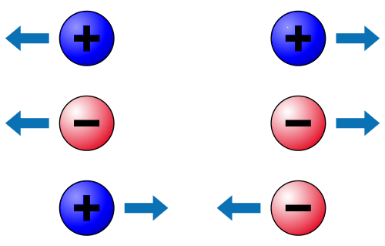
Electric Charge
What is charge?
basic property of matter (just like, say, mass)
humans cannot directly sense charge but some animals can
we can observe charge indirectly via its effects on matter
customary symbol: q or Q, unit: [q] = C (Coulomb)
+
-
Two kinds of charge:
like charges repel
unlike charges attract
Law of conservation of charge:
net amount of charge does not change in any process
(Not on your starting equation sheet, but a fact that you can use any time.)

Slide 4
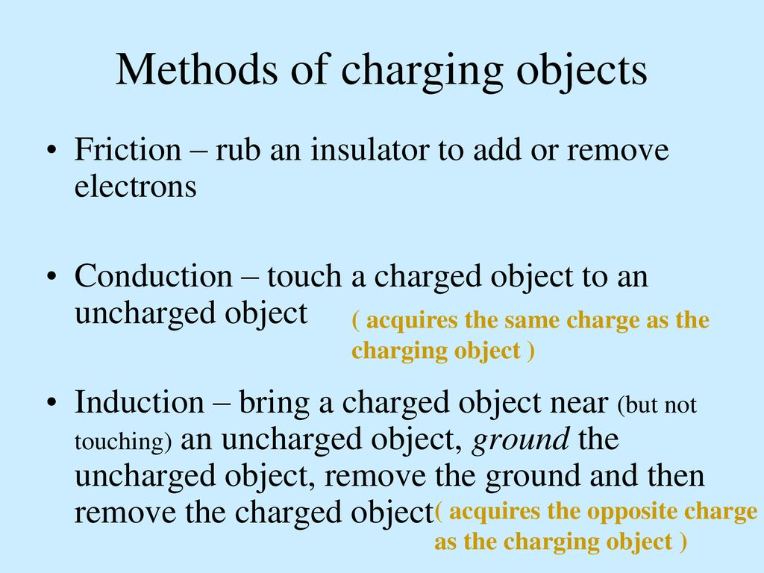

Slide 5
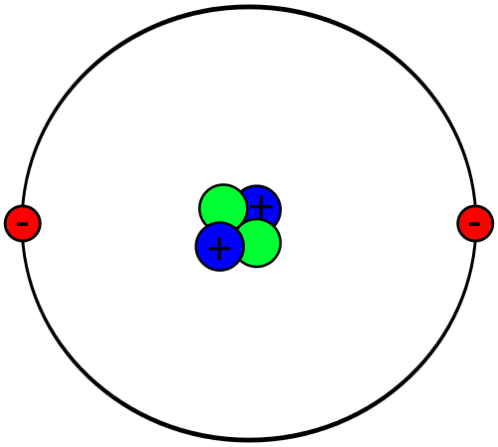
Charges are quantized (come in units of e= 1.6x10⁻¹⁹ C).
Elementary particles that make up atoms:
Protons charge +e = +1.6x10⁻¹⁹ C
Neutrons uncharged
Electrons charge –e = –1.6x10⁻¹⁹ C
+
-
Helium atom

Slide 6
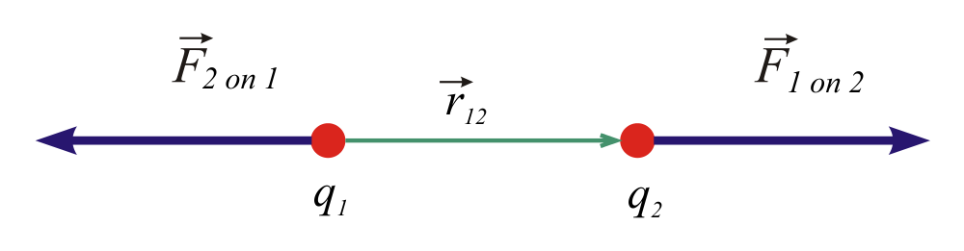
Coulomb’s Law
Force between two point charges q₁ and q₂:
force is vector, directed along connecting line
magnitude:
r₁₂ is the distance between the charges

Slide 7
a note on starting equations
is an official starting equation
in homework and exam solutions, official starting equations can be used without deriving them
all other steps of a solution need to be derived
you may formulate the official starting equation in different variables,
for example the equation is “legal”

Slide 8
Coulomb’s Law is strictly valid for point charges only.
It is a good approximation for small uniformly charged objects.
r₁₂
+
-
If more than two charges are involved, the net force is the vector sum of all forces (superposition). For objects with complex shapes, you must add up all the forces acting on each separate charge (calculus!!).
+
-
+
-
+
-

Slide 9
Coulomb’s Law:
it’s just part of a bigger picture
Coulomb's Law:
r₁₂
+
-
Q₁
Q₂
Charged particles produce forces over great distances.
How does a charged particle "know" another one is “there?”
Introduce concept of electric field
new way of thinking about the Coulomb force

Slide 10
The Electric Field
a charged particle creates a “field” in all space.
F₁₂
+
other charged particles sense the field and experience a force in response
Distinguish source charges and test charges
F₁₃
F₃₁
+
-
like charges repel
F₂₁
unlike charges attract
A charged particle modifies the properties of the space around it.

Slide 11
Definition of electric field:
one or more source charges
define the electric field via force they exert on a test charge q₀:
The subscript “0” reminds you the force is on the “test charge.”
This is your second starting equation. It is a vector equation that tells you magnitude and direction of the force!

Slide 12
The units of electric field are newtons/coulomb.
The units of electric field can also be expressed as volts/meter:
The electric field can exist independent of whether there is a charged particle around to “feel” it.

Slide 13
Gravitational Fields
The idea of a field is not new to you. You experienced fields (gravitational) in Physics 1135.
Units of g are actually N/kg!
is the local gravitational field. On earth, it is about 9.8 N/kg, directed towards the center of the earth.
A particle with mass modifies the properties of the space around it.

Slide 14
The Electric Field
Due to a Point Charge
Coulomb's law says
treat q₁ as source charge and q₂ as test charge, divide by q₂,
the electric field due to point charge q₁ is
or, generally
This is your third starting equation.

Slide 15
If we define as a unit vector from the source point to the field point…
source point
+
field point
…then the vector equation for the electric field of a point charge becomes:

Slide 16
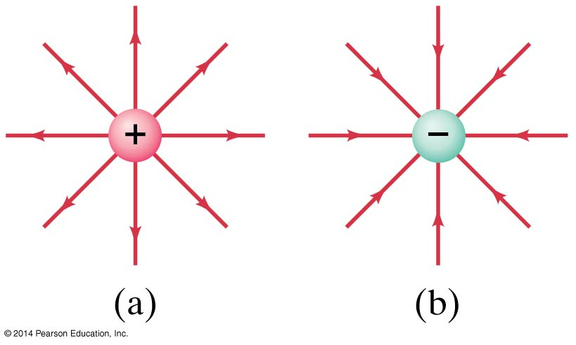
The electric field can be represented by field lines. These lines start on a positive charge and end on a negative charge.

Slide 17
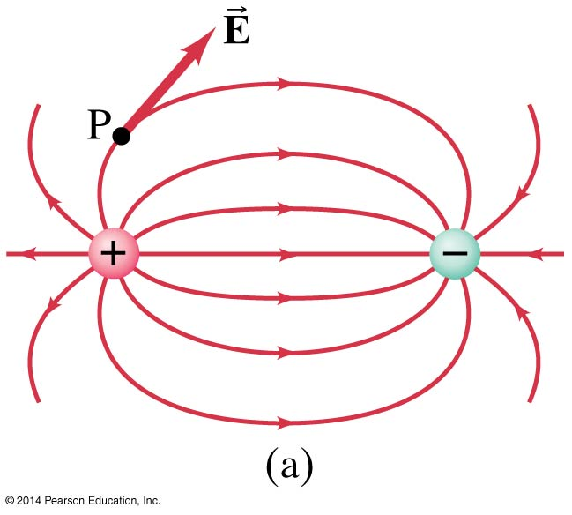
16-8 Electric Field Lines
Electric dipole: two equal charges, opposite in sign:

Slide 18
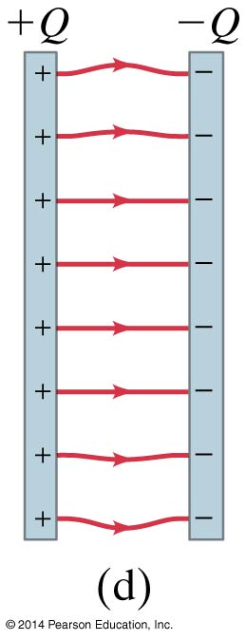
The electric field between two closely spaced, oppositely charged parallel plates is constant.

Slide 19
Summary of field lines:
Field lines indicate the direction of the field; the field is tangent to the line.
The magnitude of the field is proportional to the density of the lines.
Field lines start on positive charges and end on negative charges; the number is proportional to the magnitude of the charge.

Slide 20
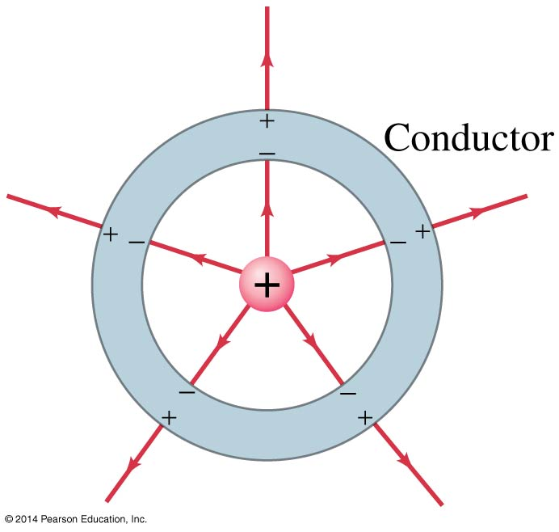
16-9 Electric Fields and Conductors
The static electric field inside a conductor is zero—if it were not, the charges would move.
The net charge on a conductor is on its surface.

Slide 21
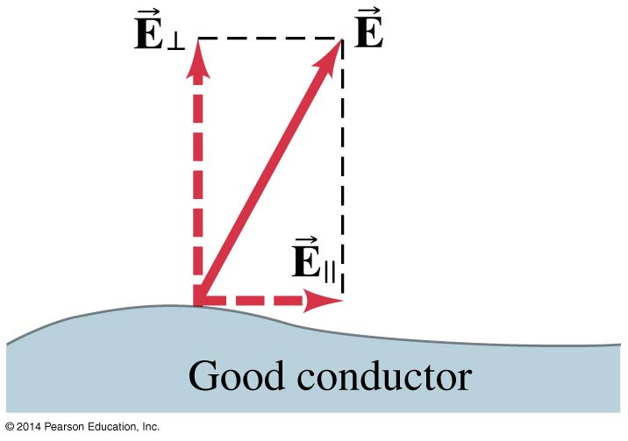
The electric field is perpendicular to the surface of a conductor—again, if it were not, charges would move.

Slide 22
Example: calculate the magnitude of the electric field at the electron’s distance away from the proton in a hydrogen atom (5.3x10⁻¹¹ m).
+e
-e
E_{P}
+
-
D
For comparison, air begins to break down and conduct electricity at about 30 kV/cm, or 3x10⁶ V/m.

Slide 23
A Dipole
A combination of two electric charges with equal magnitude and opposite sign, separated by a fixed distance, is called a dipole.
+q
+
-
-q
d
The distance between the charges is d. Dipoles are “everywhere” in nature.
This is an electric dipole. Later in the course we’ll study magnetic dipoles.

Slide 24
The Electric Field of a Dipole
Example: calculate the electric field at point P, which lies on the perpendicular bisector a distance L from a dipole of charge q.
P
L
+q
+
-
-q
d

Slide 25
Example: calculate the electric field at point P, which lies on the perpendicular bisector a distance L from a dipole of charge q.
y
E₊
P
θ
(symmetry)
θ
(symmetry)
E₋
r
L
r
θ
θ
+q
+
-
-q
x
d

Slide 26
Example: calculate the electric field at point P, which lies on the perpendicular bisector a distance L from a dipole of charge q.
y
E₊
P
θ
θ
E₋
r
L
r
θ
d/2
d/2
θ
+q
+
-
-q
x
d
“Charge on dipole” is positive by convention, so no absolute value signs needed around q.

Slide 27
THANK YOU

